Slide 1





Welcome to the international AESIS course on
Access to EU Research Funding for Universities of Applied Sciences
19-20 November, Spanish National Research Council, Brussels, Belgium

Slide 2



Access to EU Research Funding for
Universities of Applied Sciences
19-20 November 2019
DAY 1
#UASEU19
@AesisNet
WiFi: csic-bruselas
Password: Bruselas123

Slide 3
Access to EU Research Funding for
Universities of Applied Sciences
19-20 November 2019
OVERVIEW OF THE PROGRAMME
Day 1 Word of welcome by AESIS
Danielle de Boer: Taking an active role within an EU research strategy
Case Study introduction & forming groups
Bruno van Koeckhoven: Positioning of UAS within the EU context
Social programme: visit to the European Parliament
Drinks and dinner (optional)
Day 2 Otto Bruun: Building towards consortium
Future for Horizon Europe
Otto Bruun & Anika Duut van Goor: Case Study exercise
Presentations
What’s next for you?
Closing of the course

Slide 4

Access to EU Research Funding for
Universities of Applied Sciences
19-20 November 2019
Lunch break
We will start again at 13.15
#UASEU19

Slide 5
Access to EU Research Funding for
Universities of Applied Sciences
19-20 November 2019
Positioning of Universities of Applied Sciences within the EU context
Bruno van Koeckhoven
Secretary General of the Universities of Applied Sciences Network (UASnet)
#UASEU19

Slide 6




Bruno Van Koeckhoven
Secretary-General of UASnet
bruno@uasnet.eu
+32.497.17.90.50

Slide 7



Universities of Applied Sciences? UAS?
Notes:
Three worklines:
Ensuring visibility of UAS, and in particular for their applied research activities, in Brussels by lobbying and networking;
Ensuring visibility of UAS, by organising events, seminars, online activities and conferences on applied research for different target groups;
Ensuring visibility of UAS, by functioning as a spokesperson/face for UAS in Europe by providing information to relevant stakeholders on request and maintaining the UASnet website and other online information.

Slide 8
Universities of Applied Sciences? UAS?
Who are we?
How to create visibility?
How to explain the difference with other research actors?
How do we explain our research and innovation actions?

Slide 9
Applied Research by UAS?
Praxis
Applied Research = practice based research
A quick return on investment
Impact
Focus on practical solutions
User-oriented and collaborative research
Scientific and methodical research
Multdisciplinary research
Regional connectors with SME’s, public institutions, NGO’s …
Involvement of students
= interns in research projects
Regional connectors
Solving the Innovation Paradox

Slide 10

Founded in 2011
Mission & Strategy
Ensuring visibility of Universities of Applied Sciences
Ensuring visibility of their applied research activities
Providing matchmaking possibilities for European researchers
Offering information on European research programmes
Stimulating UAS to participate in European programmes
The Eduprof-project 2008-2011
Creation of UASnet
Goals
As a spokesperson to lobby with EU-stakeholders (Parliament, Commission, Council, etc.)
Networking & matchmaking activities between UAS in Europe
Enhance the cooperation between UAS:
- collecting good practices
  - collecting facts and figures to brand ourselves
  - mapping the UAS research priorities
Notes:
Project Background
The Eduprof project (Educating the new European Professional in the Knowledge Society) is an initiative of eleven rectors’ conferences of Universities of Applied Sciences throughout Europe: Ireland, Denmark, Finland, Estonia, Lithuania, Germany, Austria, Switzerland, Portugal, France, the Netherlands.
Because of changing demands on the labour market under influence of the knowledge society, Universities of Applied Sciences (UAS) are in the process to adapt their education of professionals accordingly: by embedding skills in relation to knowledge acquisition, application and applied research in the curriculum.
The Eduprof project, supported by the European Commission, enabled the eleven partners to map the various ways UAS in Europe link applied research results to education and innovation outcomes. Since the starting conference of the project in Scheveningen, February 2009, this has resulted in an overview of general trends, a SWOT-analysis, a set of indicators and peer learning opportunities.
From project to UASnet
With the Eduprof project the partners act in the heart of the European Innovation agenda, being increasingly focused on impact-driven research delivering concrete results for society and educating highly skilled professionals who bring an R&D&I mindset to the labour market.
The project offered the chance to bring the UAS sector together to reflect on the various approaches UAS take to contribute to the social and economic development of their region, in close contact with SMEs, public institutes, the social sector and not-for profit sector.
Having thus the potential to be a voice for UAS in Europe, the partners were invited by the European Commission, in particular the Director General for Research and Innovation, to organize the partnership in a more sustainable way.
That is why on 20 January 2011, the UASnet (Universities of Applied Sciences Network) has been established in Copenhagen, with support of the ten rectors’ councils of the following countries: Ireland, Denmark, Finland, Estonia, Lithuania, Switzerland, Portugal, France, Flanders and the Netherlands.

Slide 11
Members
represented through national or regional associations of UAS (rectors’ conferences)
(e.g. Vlaamse Hogescholenraad (VLHORA), Vereniging Hogescholen (VH),…)
8 EU-countries
Finland 25 UAS Henrik Wolff (Arcada UAS)
Denmark 7 UAS Lene Augusta Jørgensen (UCN UAS)
Estonia 9 UAS Anne Kraav (Talinna Tehnika UAS)
Lithuania 23 UAS Nijole Zinkeviciene (Vilniaus Kolegija)
The Netherlands 36 UAS Marjolijn Brussaard (Artez UAS Arts)
Belgium:
  Flanders 13 UAS Eric Vermeylen (VLHORA)
  Wallonia 19 UAS Cedric Bister (Synhera)
Ireland 12 UAS/IOTI Jennifer Brennan (THEA)
Portugal 20 UAS Armando Pires (Setubal UAS – CCISP)
TOTAL 157 UAS (< 1 million students)

Slide 12
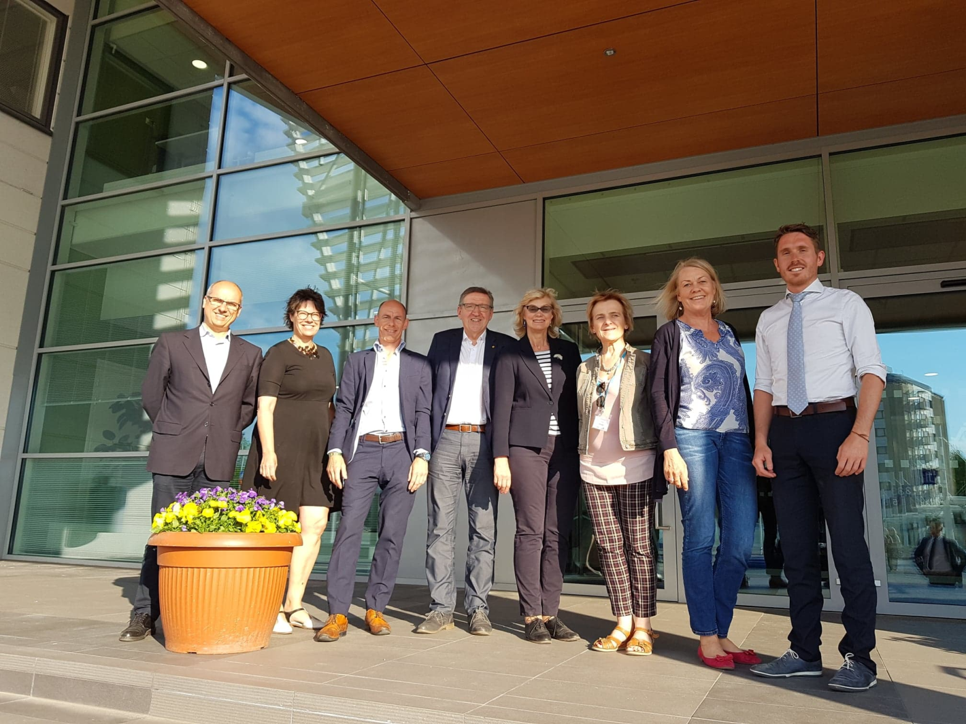
General Assembly of UASnet

Slide 13
Bruno Van Koeckhoven
Secretary-General of UASnet
bruno@uasnet.eu
+32.497.17.90.50

Slide 14




Summer of Love - 2016

Slide 15

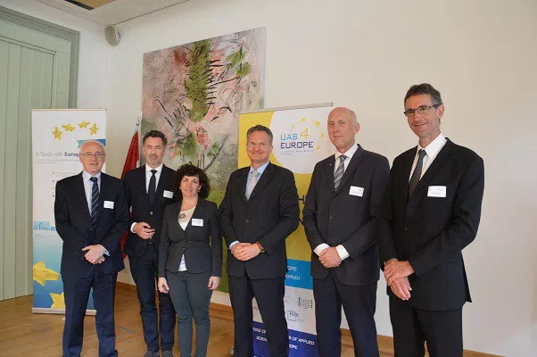

“Europe needs more and stronger involvement of the Universities of Applied Sciences” - March 2017
- Robert-Jan Smits DG RTD
Europe needs more and stronger involvement of the Universities of Applied Sciences - March 2017
EURASHE June 2016 – June 2017
Swiss UAS June 2017 – June 2018
UASnet June 2018 – June 2019
Austrian UAS (FHK) June 2019 – June 2020
Bavarian UAS June 2020 – June 2021

Slide 16


Founding Organisations
Representing all 21 Austrian UAS’s
currently UAS4EUROPE representative
FHK Austria = chair
Representing over 640 institutions in over 35 countries within and outside the European Higher Education area
EURASHE
Representing all Swiss institutions of higher education, incl. 7 UAS
Swissuniversities
Representing all the 20 Bavarian UAS
Hochschule Bayern
Representing 157 UAS in 8 EU-countries
- through national Rectors’ Conferences
UASnet

Slide 17
Organisation
UAS4EUROPE representative
One president of the founding partners representing UAS4EUROPE for one year:
Henrik Wolff, president of UASnet
UAS4EUROPE
Representative
UAS4EUROPE Organisation Committee
Representatives of all founding partners:
Preparing position papers
Lobby & communication
Organising network events
Coordinator: Bruno Van Koeckhoven (UASnet)
UAS4EUROPE Presidents’ Meeting
UAS4EUROPE
Organisation
Committee
UAS4EUROPE
Presidents’ Meeting
Meeting of the founding organisations
Coordinator: Bruno Van Koeckhoven (UASnet)

Slide 18
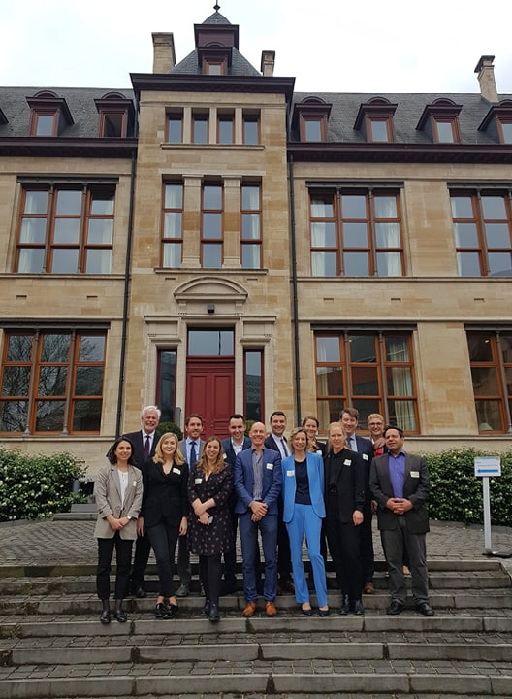
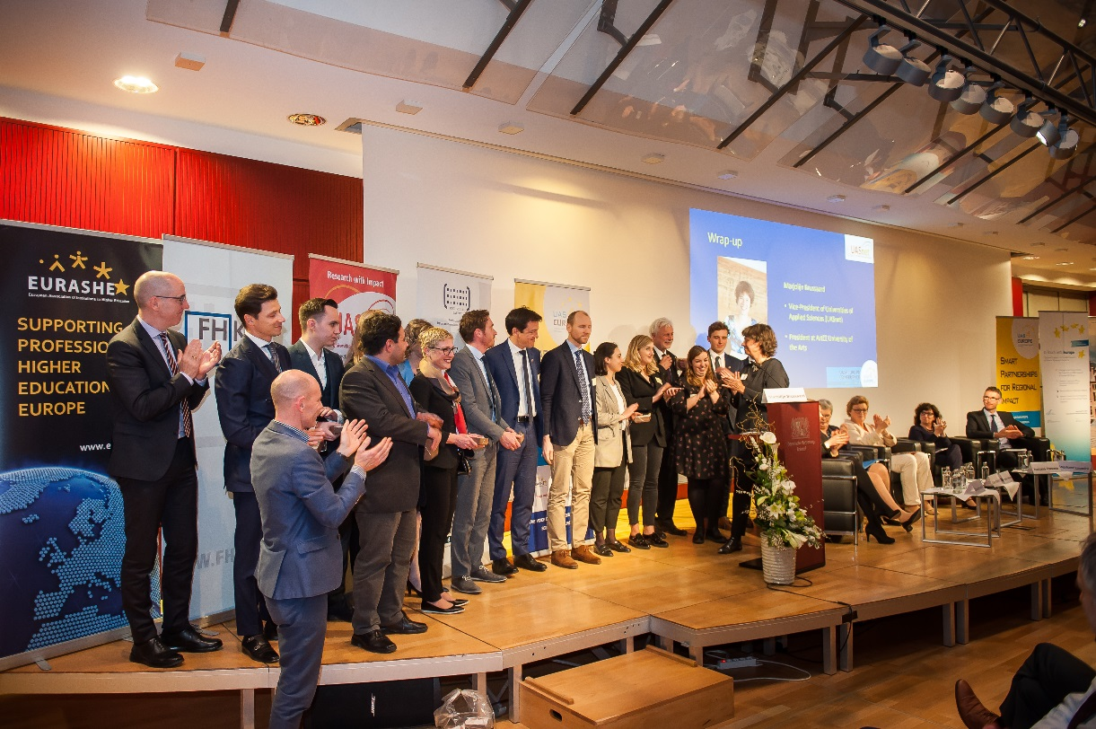
UAS4EUROPE Organisation Committee
2018 – 2019
@ Bavarian Representation to the EU

Slide 19
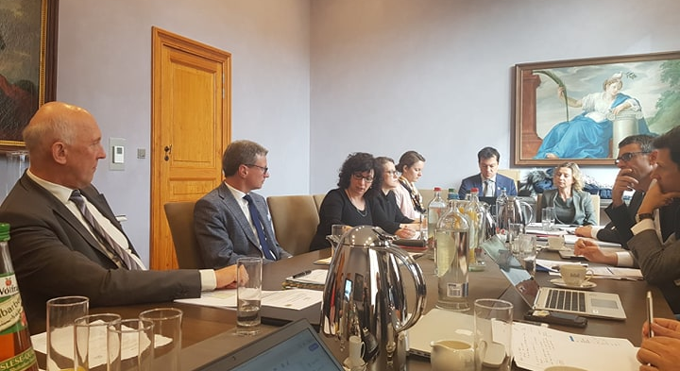
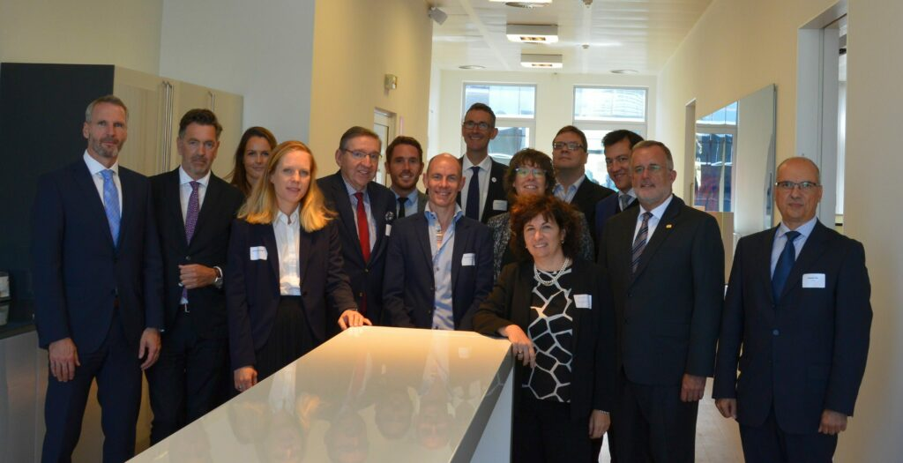
UAS4EUROPE Presidents’ Meeting
2018 – 2019
@ Embassy of The Netherlands
From left to right:
Martin Reichel (Bavarian Research Alliance); Kurt Koleznik (FHK); Naomi Krekelberg (UAS4EUROPE); Heidi Esca-Scheuringer (FHK); Henrik Wolff, Sander Hees, Bruno Van Koeckhoven (UASnet); Stéphane Lauwick (EURASHE); Marjolijn Brussaard (UASnet); Michal Karpíšek (EURASHE); Luciana Vaccaro, Otto Bruun (swissuniversities); Jürgen Lehmann (Hochschule Bayern); Armando Pires (EURASHE & UASnet)

Slide 20
Mission Statement
UAS4EUROPE aims to strengthen the voice of universities of applied sciences (UAS) in Europe in the field of applied research and innovation. It is both a networking platform for exchanging knowledge and for reaching out to European institutions and other European stakeholders to ensure a better integration and visibility of UAS in Europe’s research-and innovation policies and programmes.
The goal is to provide a common voice and to create visibility for UAS at European level and to strengthen the involvement of UAS in European policies and programmes. We further aim to highlight the particular roles of UAS and their value in Europe:
1. as smart regional connectors
2. as international key players
3. as competent project partners and project leaders for European programmes
4. as consulting bodies on research and innovation
5. as contributors to European entrepreneurship
Through these roles, UAS4EUROPE stresses the importance of the correlation between high-quality education and applied research. In practice this could be through education labs, internships and workplace learning by students.
One major challenge of EU research and innovation programmes has been to increase their impact on society. The vital role of UAS as a transmission mechanism connecting knowledge creation to citizens, small and medium-sized companies as well as public institutions in their region has not been fully realized. Europe as a whole will benefit from more actively capitalizing on the role of UAS as connectors linking citizens, companies (especially SMEs) and public institutions.
As agreed on the Presidents’ Meeting of 30 January 2019

Slide 21
What We Do
Represent research and innovation of UAS in Brussels
Increase visibility of UAS & research activities in Brussels
Contribute to shaping European research funding programmes
Inform actors on the developments on the EU-level

Slide 22
What We Do
1. Data Analysis
3.46%
2.36%
4.14%
1.07%
2.13%
1.18%
0.28%
0.88%
0.23%
0%
CH
DE
NL
AT
Flanders
HR
FI
IE
NO
SE
Participation in FP7
Source: Data extracted from the open data portal in September 2017

Slide 23
What We Do
1. Data Analysis
5%
2.84%
0.54%
1.73%
3.28%
2.10%
1.95%
0.39%
0.16%
0.43%
CH
DE
NL
AT
Flanders
HR
FI
IE
NO
SE
Participation in Horizon 2020 (mid-term evaluation November 2017
Source: Data extracted from the open data portal in September 2017

Slide 24


UAS in NL
36
14
Universities
UAS
0.54%
Participation rate of Dutch UAS in Horizon 2020 (Date: 09/2017)
0/19
Percentage of Dutch UAS being coordinator in Horizon 2020 projects (Date: 09/2017)
0.28%
Participation rate of Dutch UAS in FP7
3/25
Percentage of Dutch UAS being coordinator in FP7 projects

Slide 25

UAS in Flanders (BE)
13
5
Universities
UAS
Participation rate of Flemish UAS in Horizon 2020 (Date: 09/2017) in comparison to all Flemish projects
0.16%
0/4
Flemish UAS being coordinator in Horizon 2020 projects (Date: 09/2017)
0.23%
Participation rate of Flemish UAS in FP7 in comparison to all Belgium projects
2/14
Flemish UAS being coordinator in FP7 projects

Slide 26


UAS in AT
21
35
Universities
UAS
0.39%
Participation rate of Austrian UAS in Horizon 2020 (Date: 09/2017)
1/6
Percentage of Austrian UAS being coordinator in Horizon 2020 projects (Date: 09/2017)
0.88%
Participation rate of Austrian UAS in FP7
1/33
Percentage of Austrian UAS being coordinator in FP7 projects

Slide 27

UAS in CH
7
12
Universities
UAS
5.00%
Participation rate of Swiss UAS in Horizon 2020 (Date: 09/2017)
3/69
Percentage of Swiss UAS being coordinator in Horizon 2020 projects (Date: 09/2017)
3.46%
Participation rate of Swiss UAS in FP7
17/170
Percentage of Swiss UAS being coordinator in FP7 projects

Slide 28
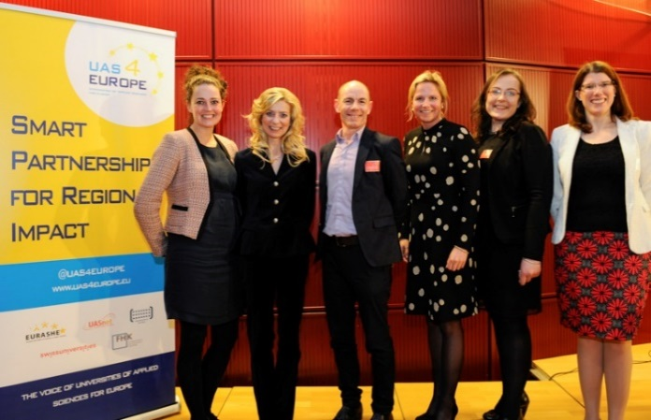
What We Do
2. Position Papers
UAS4Europe Position paper on FP9 – November 2017
Succesful lobby by the Swiss chair of UAS4EUROPE

Slide 29
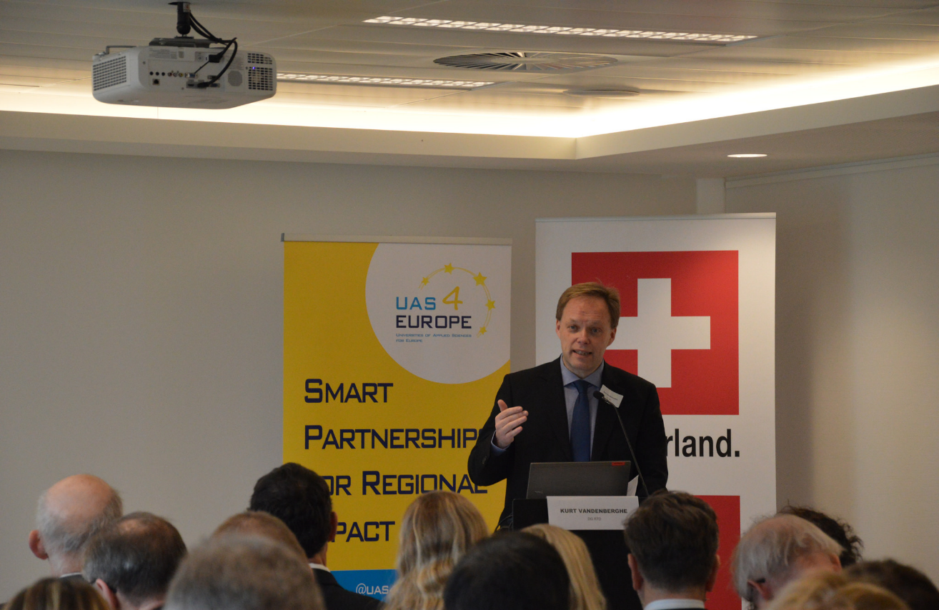
What We Do: Croissant Events
3. Croissant Events
Europe needs more and stronger involvement of the Universities of Applied Sciences
“UAS play a key role in the ambitions of the new Framework Programme (FP9) of the European Commission”
- Kurt Vandenberghe, Director Policy Development at Directorate-General Research (RTD) of the European Commission
Croissant Event
- 28 Februari 2018 (Swiss Embassy)

Slide 30
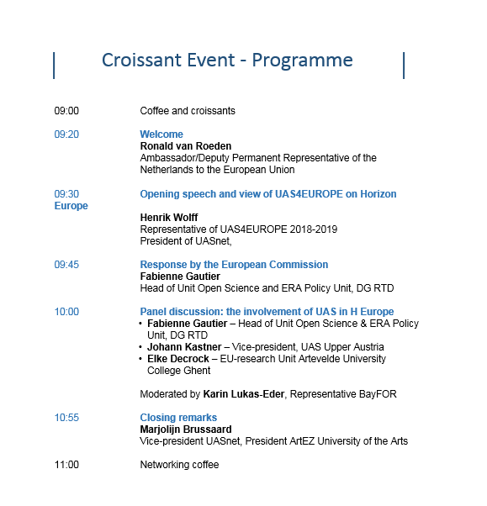
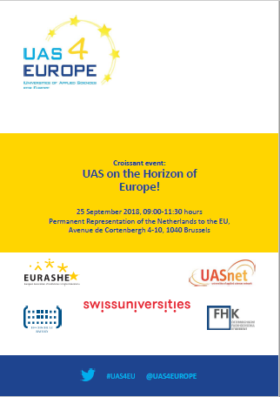
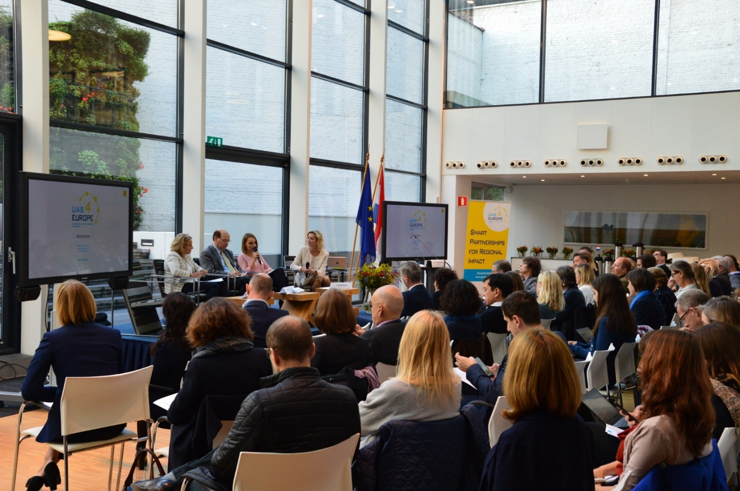
What We Do
3. Croissant Events
Europe needs more and stronger involvement of the Universities of Applied Sciences
Croissant Event – UAS on the Horizon of Europe?
- 25 September 2018 (Dutch embassy)
Presenting UAS4EUROPE Position Paper on Horizon Europe

Slide 31
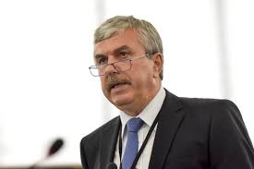
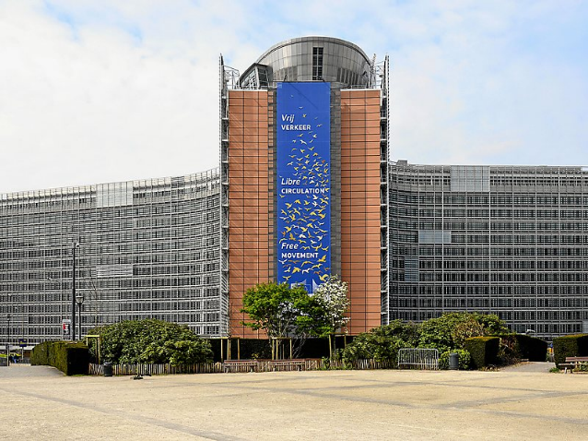
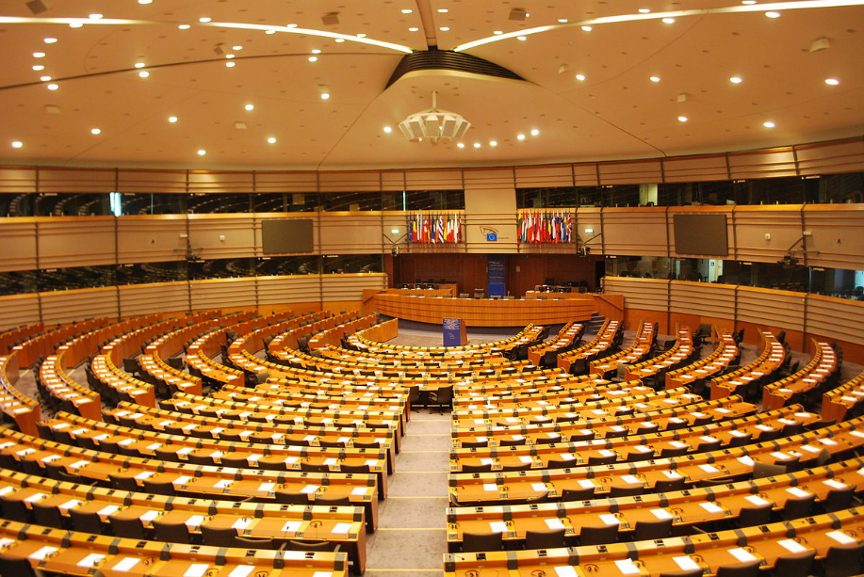
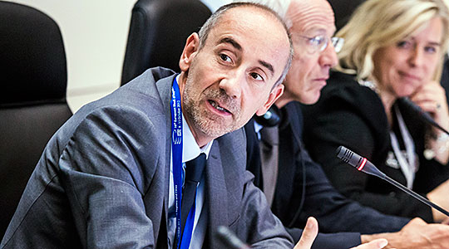
What We Do
4. Lobby
Dan Nica
Member of Parliament (MEP)
Rapporteur FP9
‘Horizon Europe’
Parliamentarian Commission ITRE
Jean-Eric Paquet
Director-General
DG RTD
European Commission (EC)
Notes:
Three worklines:
Ensuring visibility of UAS, and in particular for their applied research activities, in Brussels by lobbying and networking;
Ensuring visibility of UAS, by organising events, seminars, online activities and conferences on applied research for different target groups;
Ensuring visibility of UAS, by functioning as a spokesperson/face for UAS in Europe by providing information to relevant stakeholders on request and maintaining the UASnet website and other online information.

Slide 32
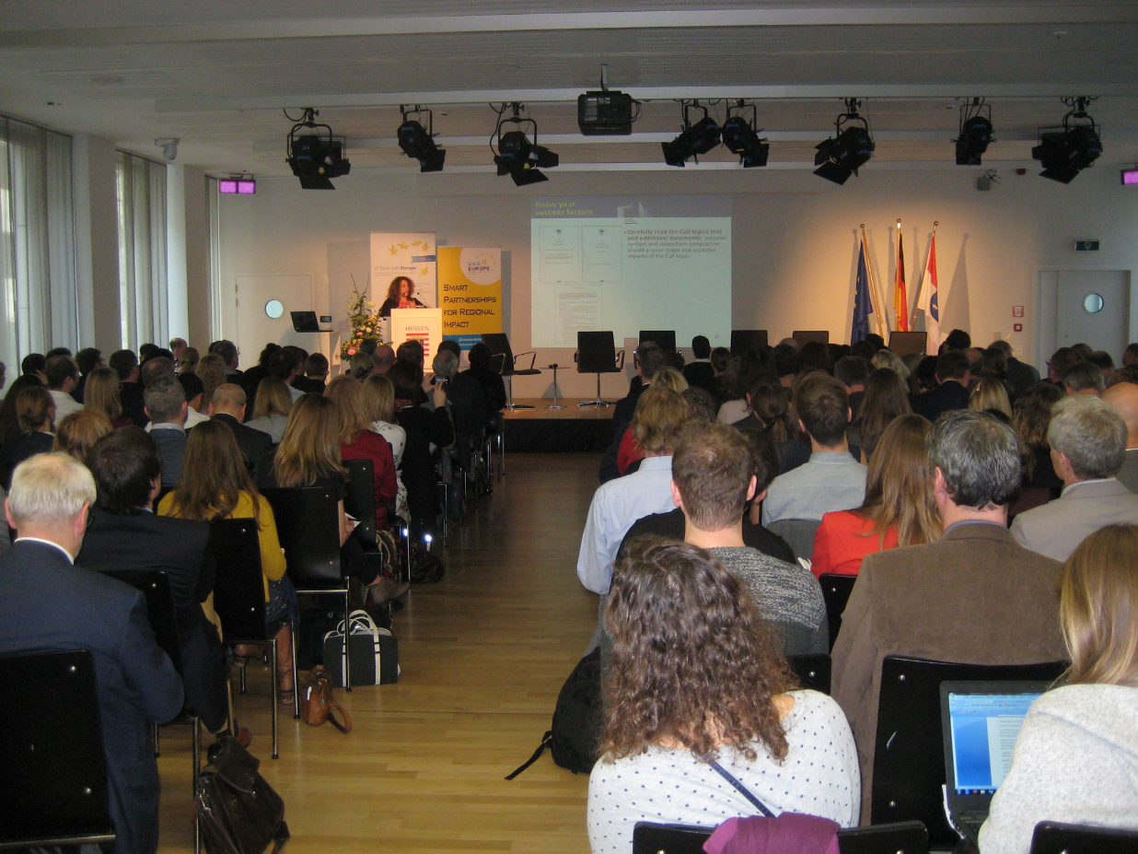
What We Do
5. Conferences
UAS4Europe Conference – 15 March 2017
- 240 UAS-participants
- 25 European countries
UAS4EUROPE-Conference – 15 March 2017
240 participants from UAS’s in Europe
25 European countries

Slide 33
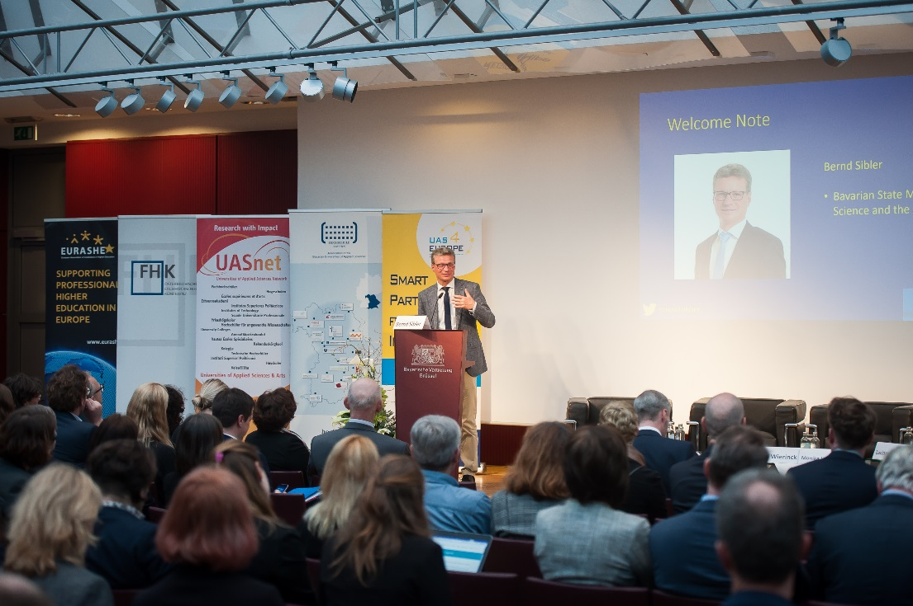
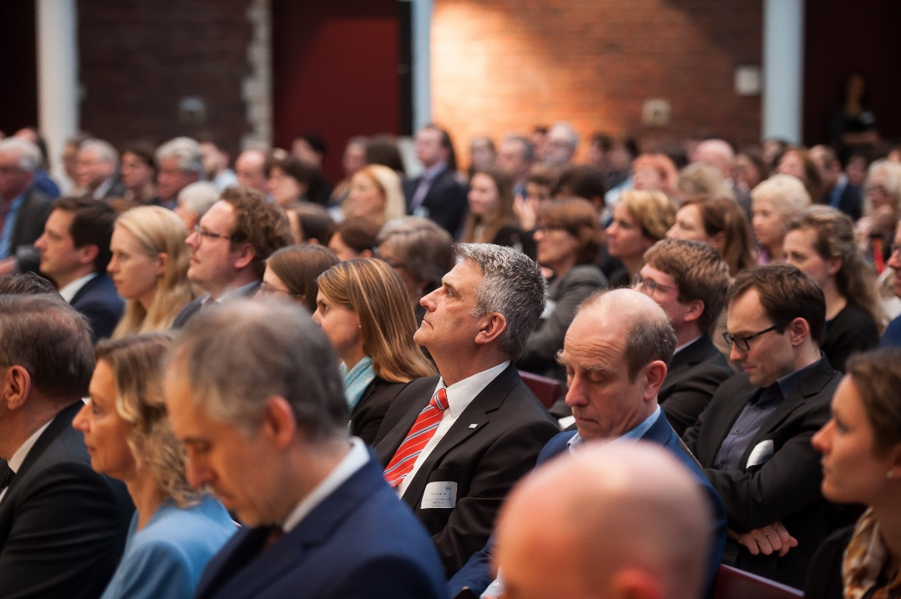
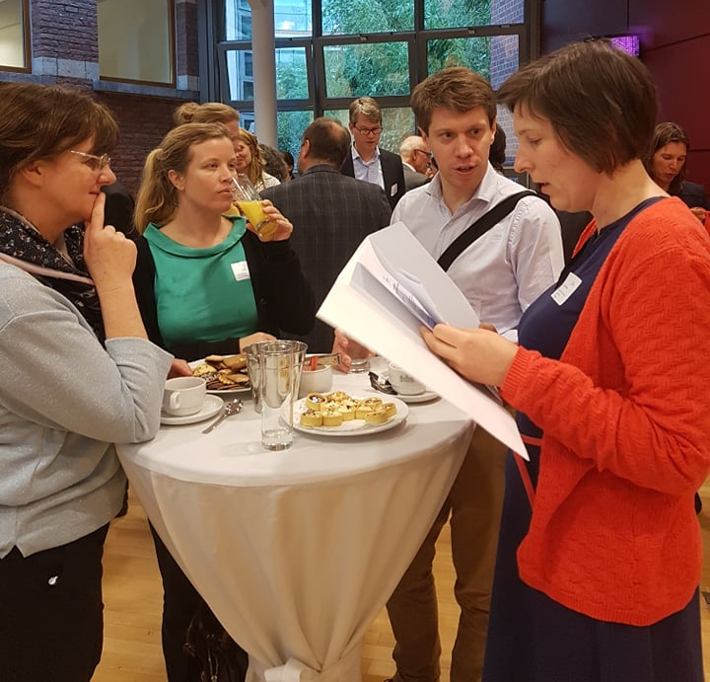
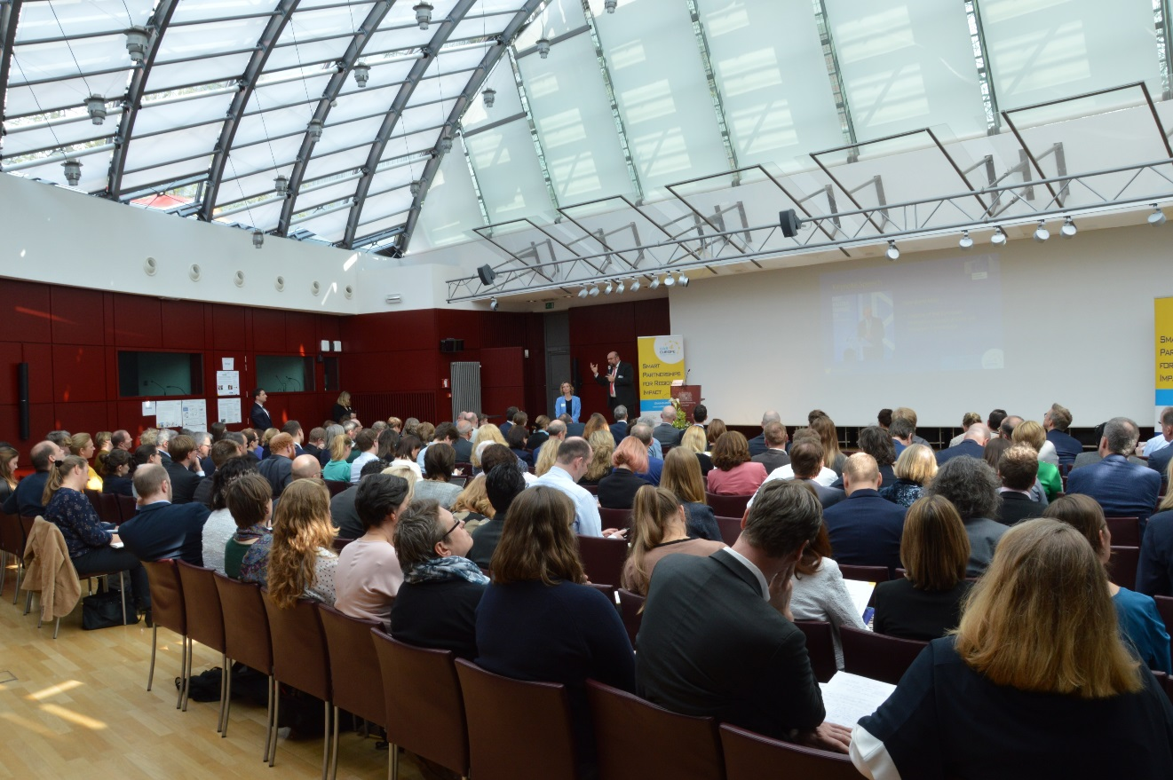
UAS4EUROPE Conference – 2 April 2019
“Beyond Horizons - The future of applied research in Europe”
202 individual attendees
20 European Countries

Slide 34
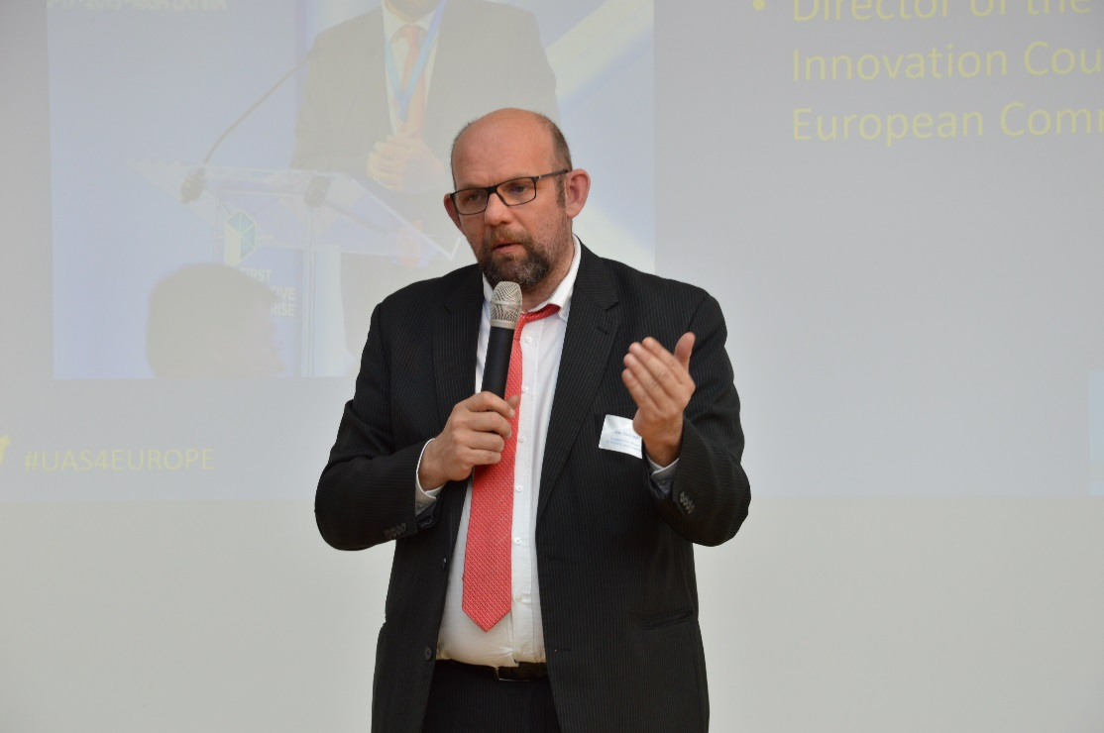
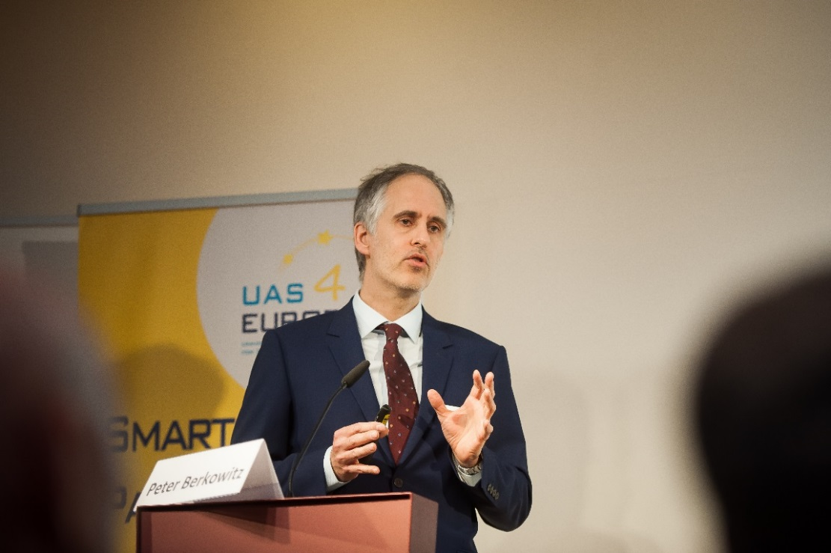
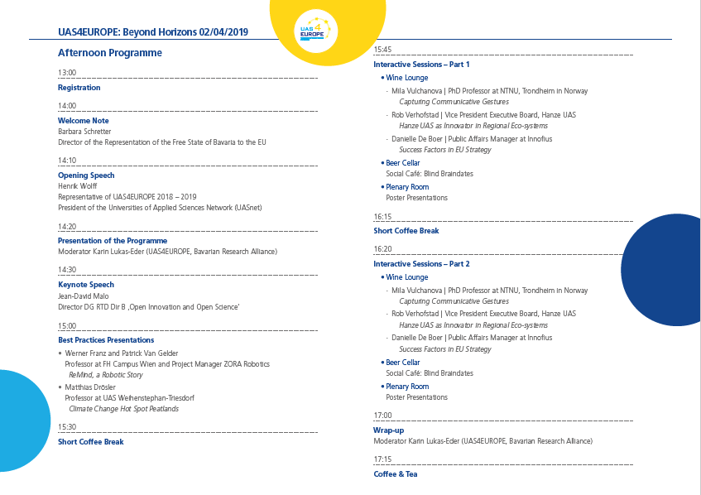
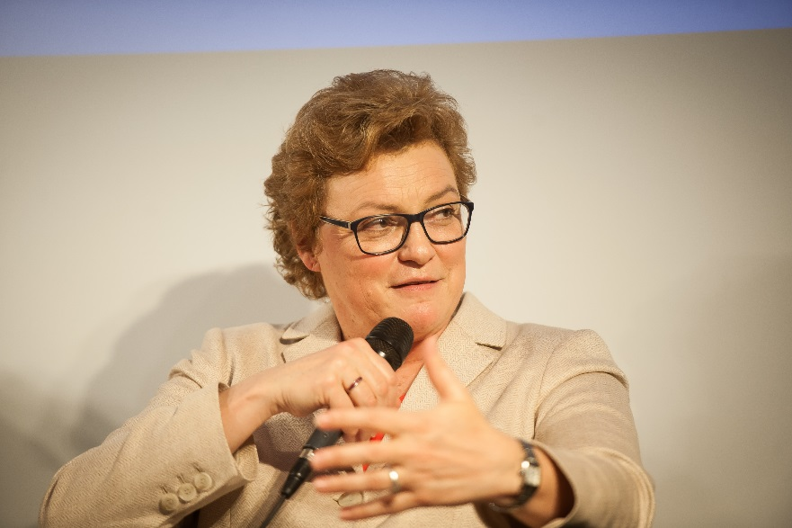
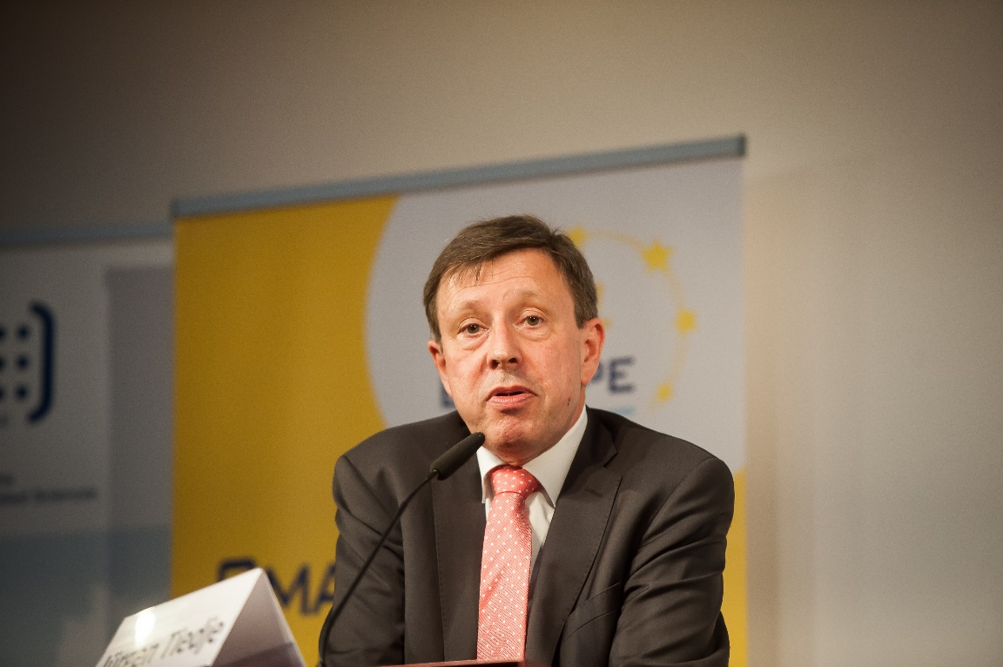
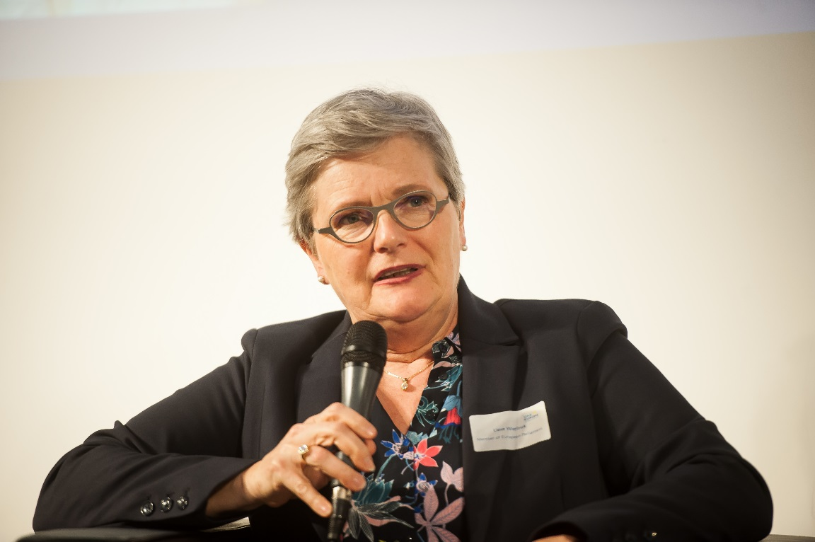
Conference - Programme

Slide 35
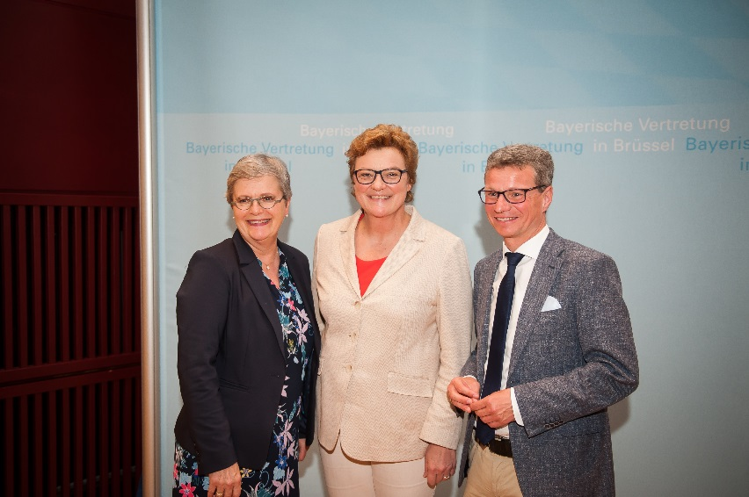
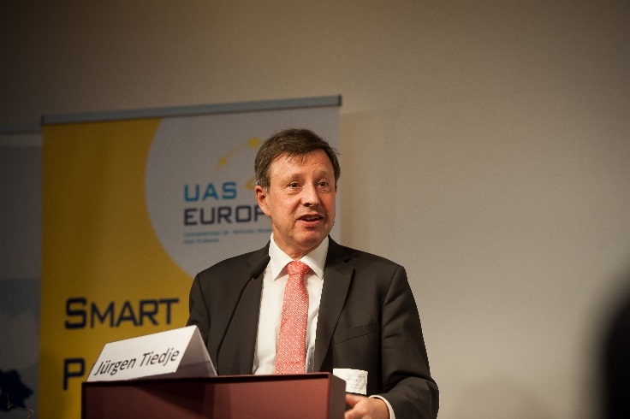
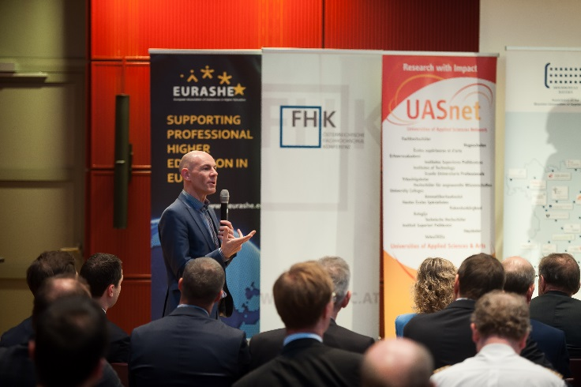
Supported by MEP’s:
UAS on the Horizon of Europe
MAIN RECOMMENDATIONS
UAS4EUROPE proposes an increase of the Horizon Europe budget to at least €120 billion;
To reach the goals as stated under the Marie Skłodowska-Curie Actions (MSCA) the European Commission should support a better inclusion
of applied researchers;

Slide 36
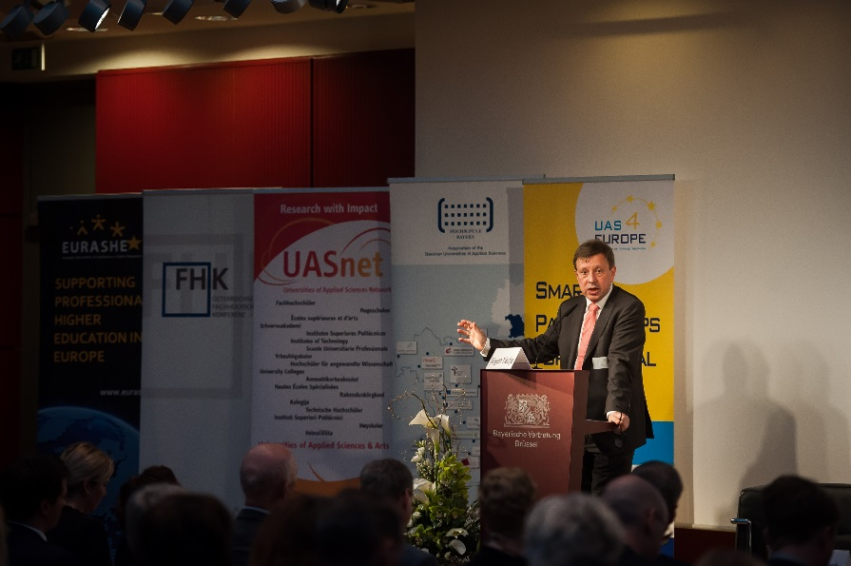
UAS on the Horizon of Europe
MAIN RECOMMENDATIONS
The European Commission should ensure a better integration of Social Sciences, Humanities and Arts (SSHA) in the second pillar of Horizon Europe. In addition, UAS4EUROPE supports the separation of the cluster Inclusive and Secure Societies into ‘Inclusive & Creative Society’, on the one hand, and a ‘Secure Society’-cluster on the other;
Better indicators need to be established to measure the exact societal impact of research-projects funded by the European Union.
Third Pillar: the incremental part of the innovation value-chain is too often forgotten. Therefore UAS4EUROPE strongly supports the proposed extra investment in incremental research (800 million) as suggested by the European Parliament-rapporteur Dan Nica (July 2018);
Facts
Figures
UAS

Slide 37
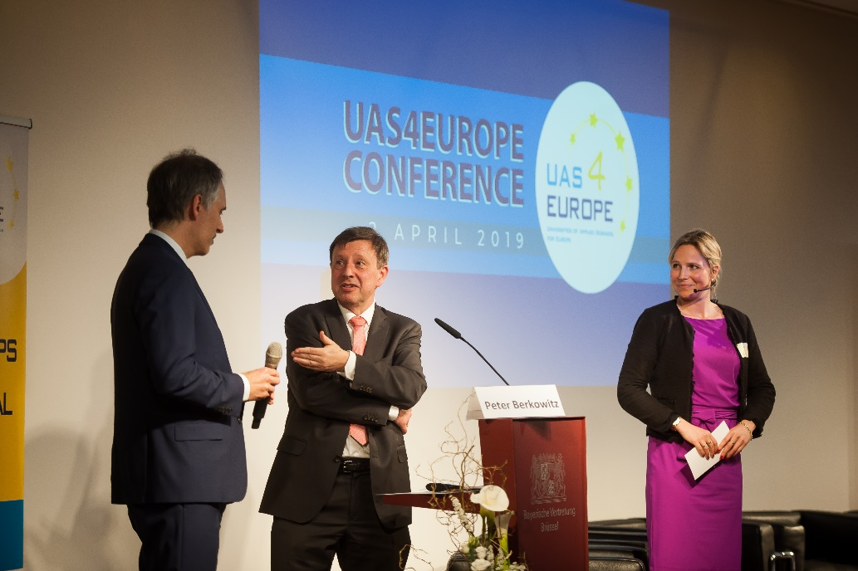
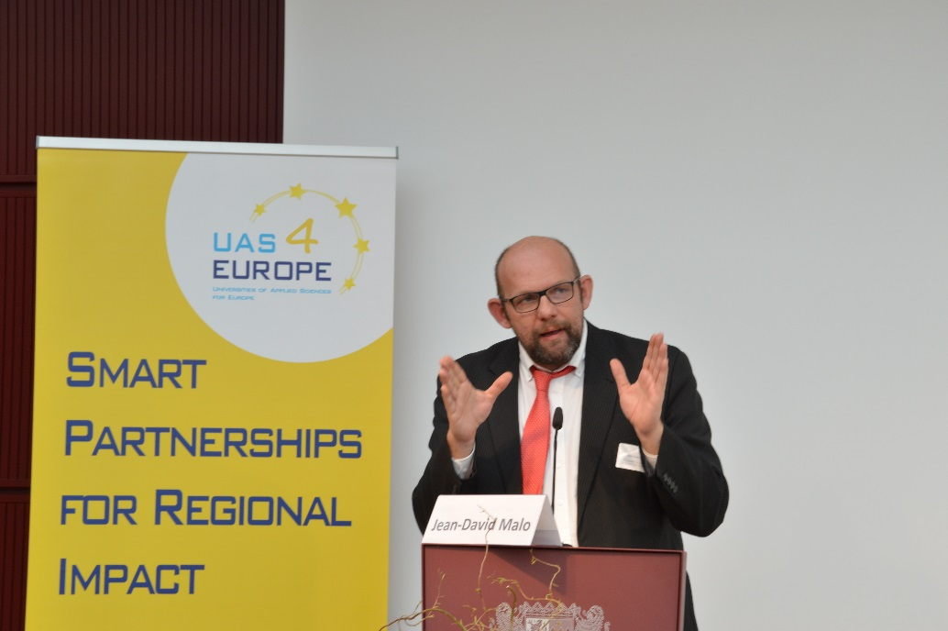
UAS on the Horizon of Europe
MAIN RECOMMENDATIONS
6. Multidisciplinary research involving different stakeholders is at the heart of European R&I programmes. UAS are important breeding grounds for this type of research and provide excellent impact-oriented research results. Funding of small- scale multidisciplinary projects would increase active participation of UAS, together with partners from SMEs and start-ups, thus further stimulate the effectiveness of European research programmes;
7. UAS4EUROPE supports the mission oriented approach proposed by the European Commission. Mission Boards (EIC, EIT) should have a strong multi-disciplinary character thus include representatives, researchers and/or experts from UAS.

Slide 38
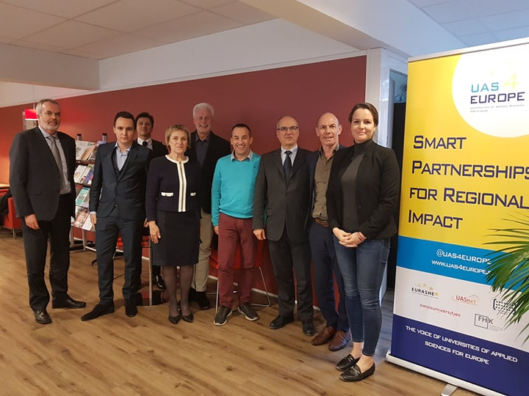
Working Group RDI-Indicators of UAS
Meetings on 5 December 2018 and 21 February 2019
11 European countries

Slide 39
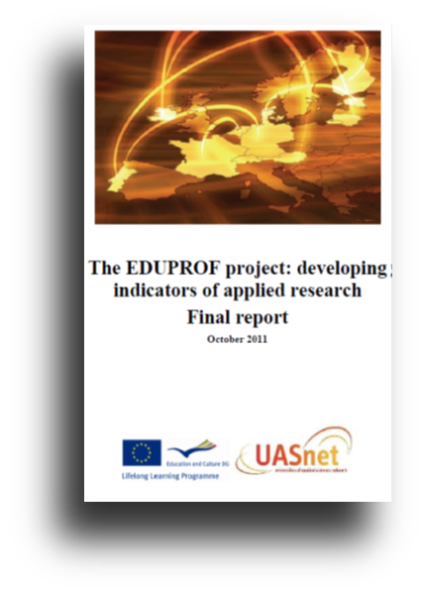
Research and Innovation Indicators - project Development and Innovation In
Developments
1. Research & Innovation Working Group - 5 December 2018 - Brussels
- proposal of VLHORA-research indicators (since 2012)
- definitions of input & output-research indicators
- Finland, Estonia, Lithuania, The Netherlands, Flanders & Wallonia,
Ireland, Austria, Switzerland, Portugal, Bavaria and Malta
2. Research & Innovation Working Group - 21 February 2019 – Brussels
- feasibility analysis: choice of research-indicators
- discussion on definitions
- final decisions: 5 input-indicators, 1 output-indicator and 1 general indicator
3. Analysis Bachelor-paper (by UASnet-intern Alec Moons) – September 2019
- further analysis of provided numbers
- future efforts are necessary

Slide 40









Input-Indicators
Output-Indicators
Labour market partners (private & public)
Knowledge centres in RDI-projects
Scientific & Professional Publications
Lectures & Poster Presentations (labour market & scientific world)
Symposia at your UAS
Number of UAS
Number of students
Yearly public research budget
Amount of researchers

Slide 41
UAS4EUROPE Stats & Figures – February 2019

Slide 42






Input-Indicators
Output-Indicators
Number of UAS
Number of students
Yearly public research budget
Yearly Private research budget
Researchers
Labour market partners (private & public)
Knowledge centres in RDI-projects
Scientific & Professional Publications
General-Indicator
Employability

Slide 43
Research and Innovation Indicators – project
Analysis Bachelor-paper (by UASnet-intern Alec Moons) – September 2019

Slide 44
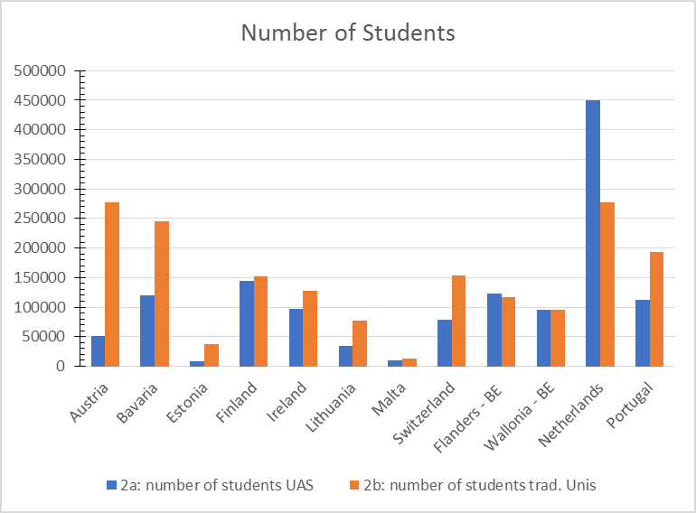
Research and Innovation Indicators – project
Analysis Bachelor-paper (by UASnet-intern Alec Moons) – September 2019

Slide 45
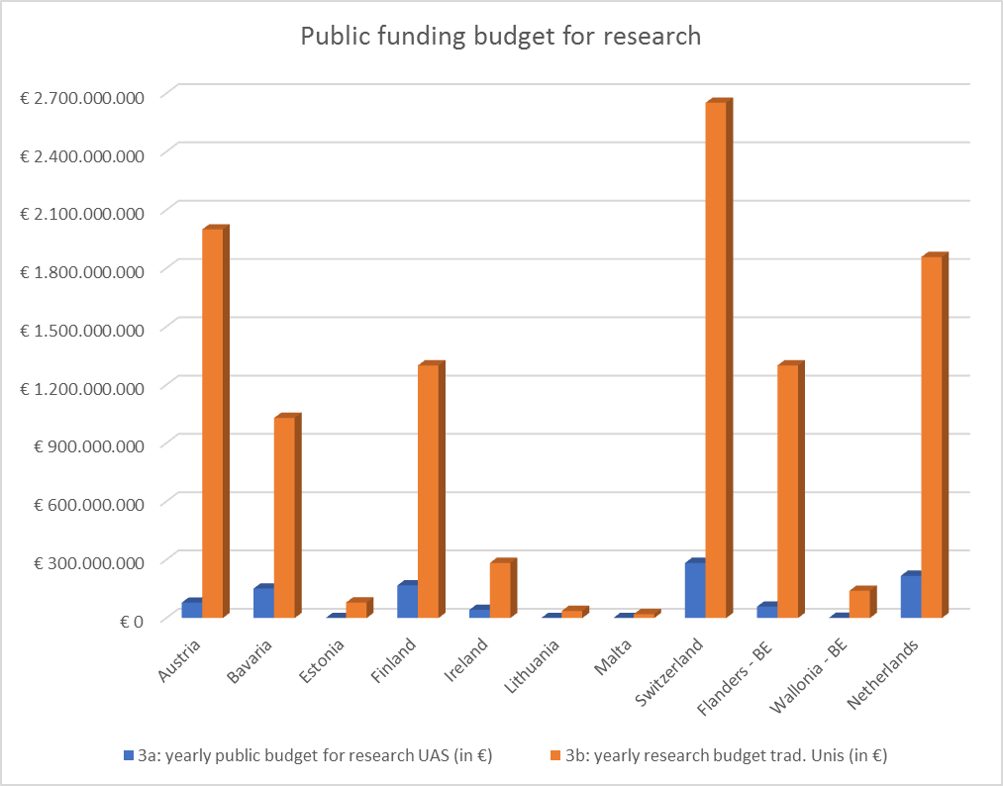
Research and Innovation Indicators – project
Analysis Bachelor-paper (by UASnet-intern Alec Moons) – September 2019

Slide 46
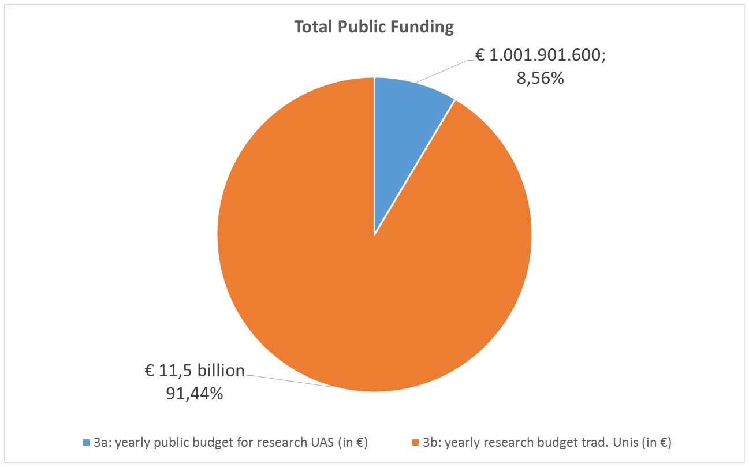
Research and Innovation Indicators – project
Analysis Bachelor-paper (by UASnet-intern Alec Moons) – September 2019

Slide 47

https://www.youtube.com/watch?v=XDVBMY06RLE

Slide 48
Bruno Van Koeckhoven
Secretary-General of UASnet
bruno@uasnet.eu
+32.497.17.90.50

Slide 49
Access to EU Research Funding for
Universities of Applied Sciences
19-20 November 2019
Coffee/tea break
We will start again at 15.30
#UASEU19

Slide 50
Access to EU Research Funding for
Universities of Applied Sciences
19-20 November 2019
Discussion and Q&A
#UASEU19

Slide 51
Access to EU Research Funding for
Universities of Applied Sciences
19-20 November 2019
Social Programme
Visit to the European Parliament
16.30: Paul-Henri Spaak Building – Rue Wiertz/Wiertzstraat 60
Group tour
Drinks and dinner (optional)
17.30: Monument à John Cockerill, Plux
19.00: Brasserie Leopold
Can’t find us? +31 6 512 44 951
#UASEU19

